Slide 1
Flipped Classroom Discussion
Simulation with R

Slide 2
When to stop?
Case 1

Slide 3
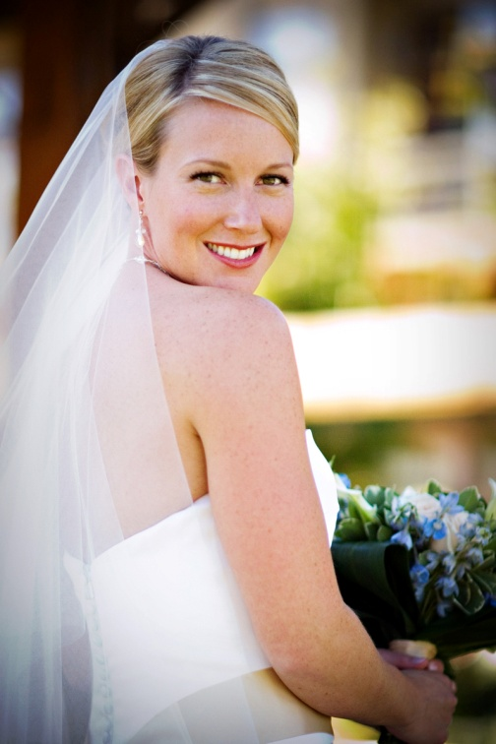
Mathematics & Marriage
You make a succession of friendships.
A friendship comes to an end when you decide that the current friend is not suitable to be your partner.
Eventually you find "Mr Right" or "Miss Right" and then you make the decision not to go on looking any more.
Game rule
you can't go back to one of the people that you have rejected earlier
you can't find out much about anyone who might come along later

Slide 4
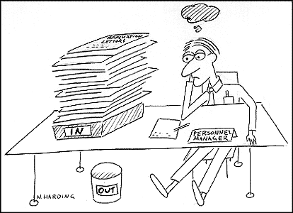
Employment Problem

Slide 5
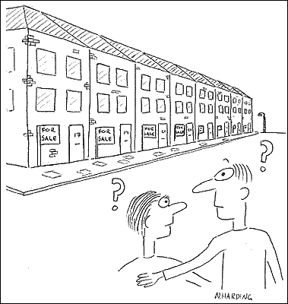
House Searching

Slide 6
Optimal Stopping
We will assume that if you looked at all the potential partners (or sums of money), you could put them into order without making any two equal. But if you can't look at all of the partners, you must be able to work out the order for those that you have seen, and be able to tell if you meet someone who is better than any of them. We will assume that there are N potential partners, who could be ranked 1 (the worst) to N (the best).

Slide 7

Optimal Stopping
Assuming N = 4.
There are 24 possible orders:

Slide 8
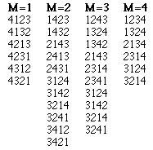
Optimal Stopping
Optimal policy
Look at M-1 of the potential partners (where M ranges from 1 to N) and then choose the first one who comes along afterwards who is better than the best that you have seen among those M-1.

Slide 9
Task
If you target at “interviewing” 30 potential partners, what is the optimal stopping M?
If N is extremely large, what is the percentage of N to be set as stopping M?

Slide 10
Airline Discounted Seats
Case 2

Slide 11
Background
ABC Airlines has 100 economic class seats available in its flight from Singapore to Shanghai.
Full price fare is $590. ABC is considering selling some seats at a discounted price of $450.
The demand of the flight follows normal distribution with mean 110 and standard deviation 30.

Slide 12
Background
Based on past experience, ABC is able to sell all discounted tickets as long as there is demand.
However, only 60% of the customers will buy full fare ticket when no more discounted tickets available.

Slide 13
Question 1
Build a simulation model to decide the optimal number of seats to be reserved as full fare seats.
Answer: 31
Notes:
31

Slide 14
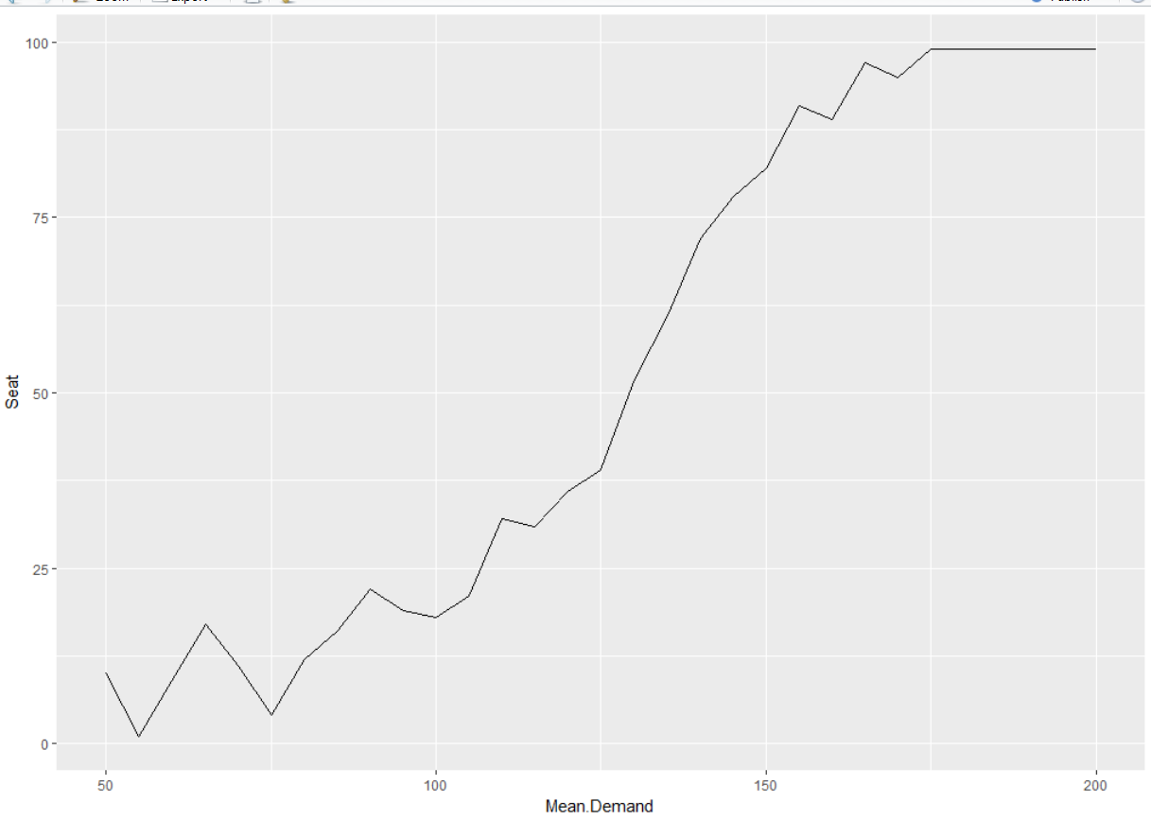
Question 2
What if the mean demand change? How will it affect the full fare seats allocation?

Slide 15
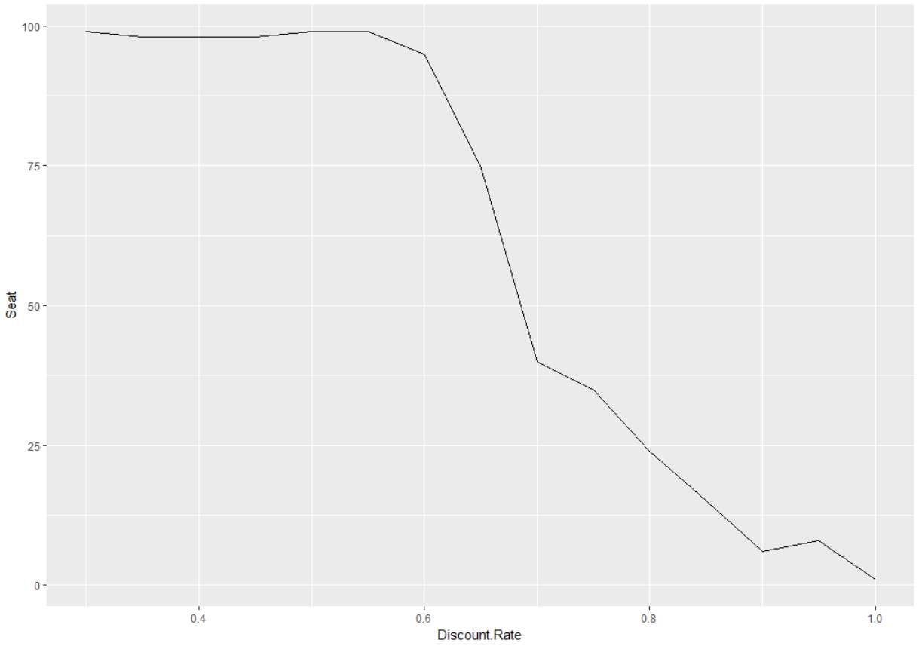
Question 3
What if discount percentage change? How will it affect the full fare seats allocation?

Slide 16
Question 4
What is the best combination of seat allocation and discount percentage with respect to a particular demand?

Slide 17
Machine Replacement
Case 3

Slide 18
Background
At the beginning of each week, a machine is in one of four conditions:
1 = excellent
2 = good
3 = average
4 = bad
The weekly revenue earned by a machine in state 1, 2, 3, or 4 is $100, $90, $50, or $10, respectively.

Slide 19
Background
The quality of the machine deteriorates over time.
 |  | State at beginning of next week
 |  | 1 | 2 | 3 | 4
State at beginning | 1 | 0.7 | 0.3 | 0 | 0
of this week | 2 | 0 | 0.7 | 0.3 | 0
 | 3 | 0 | 0 | 0.6 | 0.4
 | 4 | 0 | 0 | 0 | 1

Slide 20
Background
After observing the condition of the machine at the beginning of the week, the company has the option, for a cost of $200, of instantaneously replacing the machine with a machine at excellent state.

Slide 21
Decision Problem
The company needs to decide which of the following replacement policies to apply:
Policy 1: Never replace a machine
Policy 2: Immediately replace a bad machine
Policy 3: Immediately replace a bad or average machine
Policy 4: Immediately replace a bad, average, or good machine

